Slide 1

The Sherry Institute of Spain
Notes:
Sherry, possibly our best known, least known wine.

Slide 2

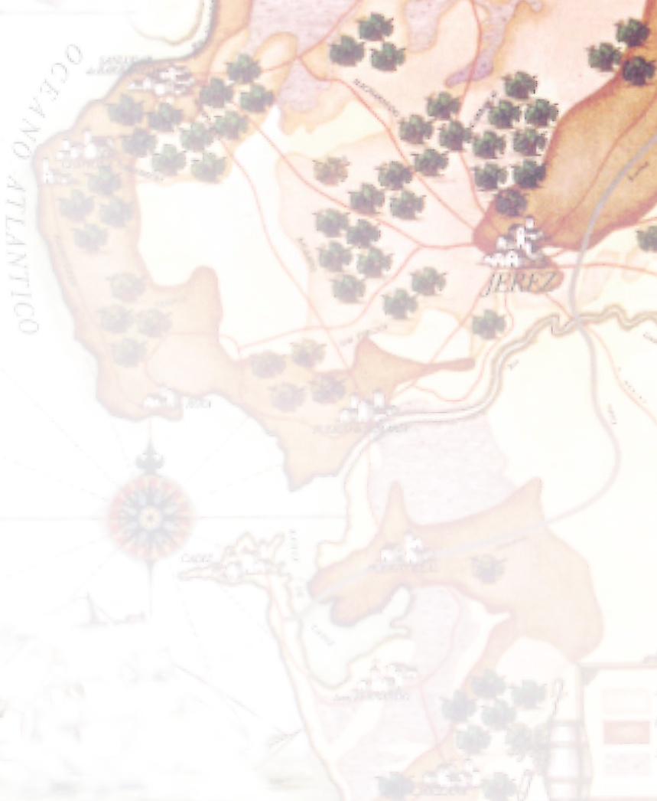
a very special origin
The origin of Sherry
Andalucia, Spain.
The southern-most wine region in Europe.
F r a n c e
Spain
P o r t u g a l
Jerez

Slide 3
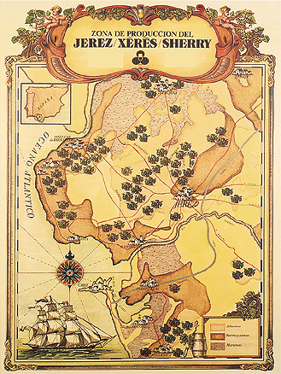
a very special origin
The origin of Sherry wines
Demarcated area – the “Sherry Triangle”:
- Jerez de la Frontera
- El Puerto de Santa María
- Sanlúcar de Barrameda
Sanlúcar
Jerez
El Puerto
10.500 hectares of vineyard protected by the “Denomination of Origin”.

Slide 4

3,000 years of history
Same town,different names,
from Xera to Jerez de la Frontera
Tartessos
10 BC
Phoenicians
F r a n c e
5 BC
Greeks
Carthagineans
2 BC
Roman Empire
Spain
0
P o r t u g a l
Goths
5 AD
8 AD
Arabic domination
A f r i c a
13 AD
Christian “reconquista”
15 AD
Discovery of America

Slide 5
3,000 years of history
Same town, different names
6 BC
II BC
8 AD
13 AD
16 AD
today
Jerez
Xerez
Sherish
Xeres de la Frontera
Ceret
Sherrish
Xera
Sherry
Sherry = Jerez

Slide 6
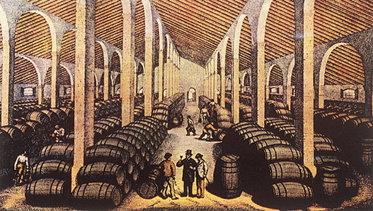
3.000 years of history
Early XIXth C. – Sherry as we know it
Abolition of the Vintners Guild.
Use of fortification as an oenological tool.
Need of a consistent quality – birth of the “Solera system”

Slide 7
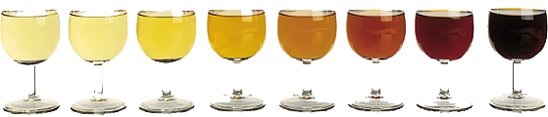
The Denominations of Origin
Three different D.O.´s...
...with one single origin.
JEREZ-XÉRÈS-SHERRY
MANZANILLA – SANLÚCAR DE BARRAMEDA
VINAGRE DE JEREZ

Slide 8
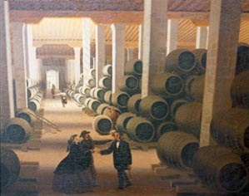
3,000 years of history
The key role of foreign traders
Numerous traders (mainly British) established themselves in the region
Association with local shippers and growers.
Increasing pressure to liberalise the trade.
In the U.K.
Become a firm favourite over the Centuries, mentioned by Shakespeare, Dickens, etc.
Poet Laureate’s rewarded with it!

Slide 9
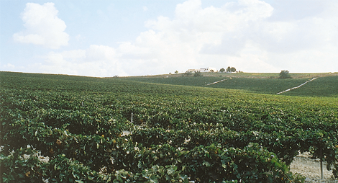
a very special origin
Main climatic factors
Very high levels of sunlight (300 days of sunshine per annum).
Mild winters (4º C) and very extreme summers (40º C).
Average rainfall of approx. 620 litres per square metre.
Key influence of the predominant winds: Levante (east) and Poniente (west).

Slide 10
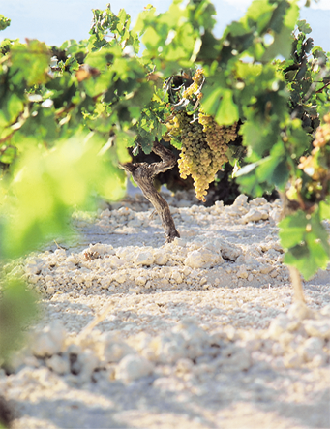
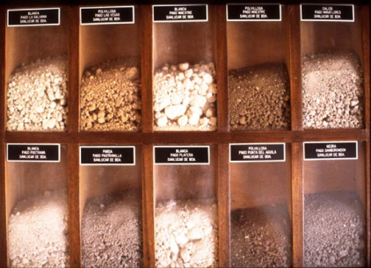
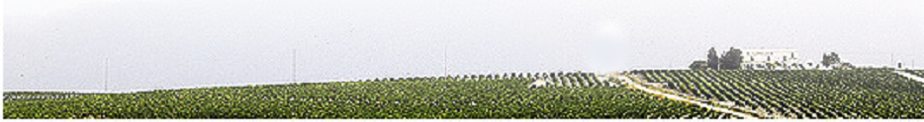
Sherry viticulture
The “albariza” soil.
Very chalky (high content in clacium carbonate).
High level of porosity – helps keeping the humidity.
White colour (“alba”).
Other types of soil:
- arenas (coastal areas)
- barros (valleys)

Slide 11
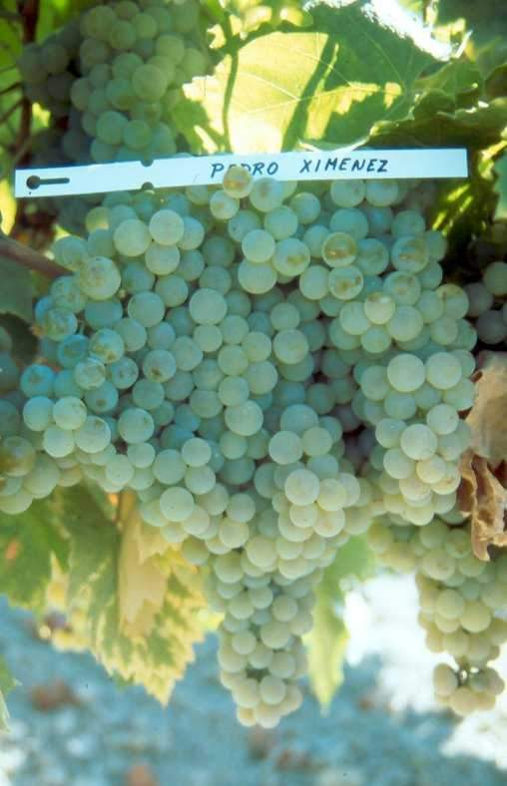
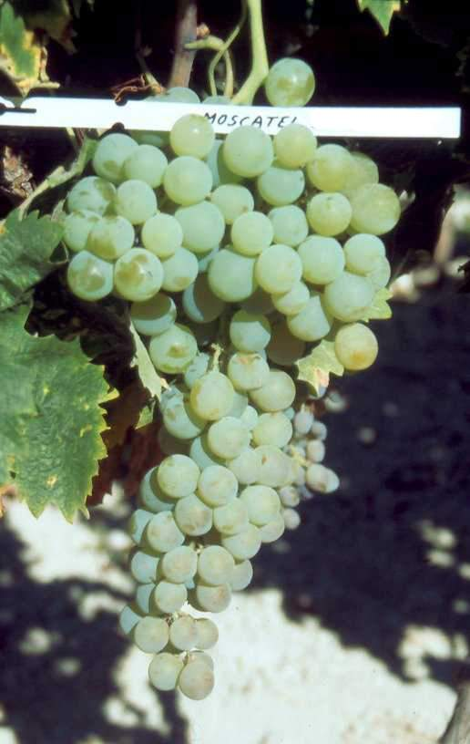
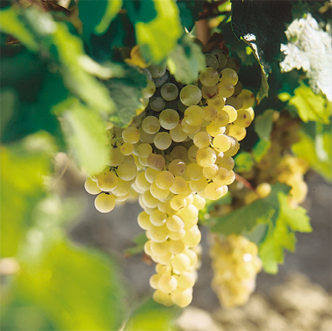
Sherry viticulture
Authorised grape varieties.
pedro ximénez
palomino
moscatel

Slide 12
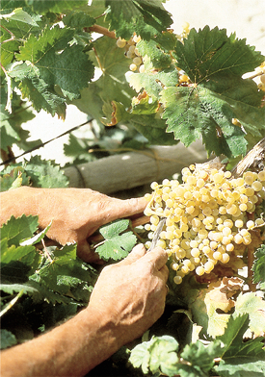
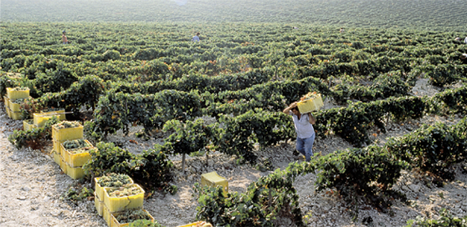
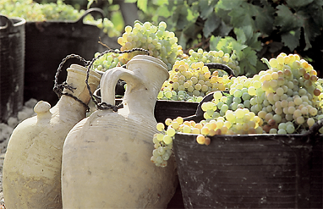
Sherry wine-making
The Harvest
Early ripening of the grapes - September.
11 to 12,5º baumé.
90% hand-picked.
Need of rapid harvesting

Slide 13

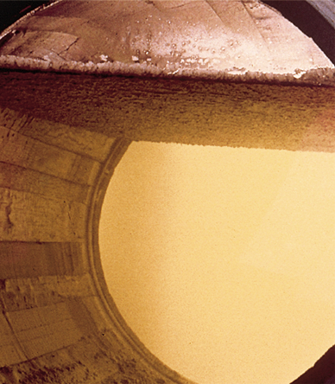
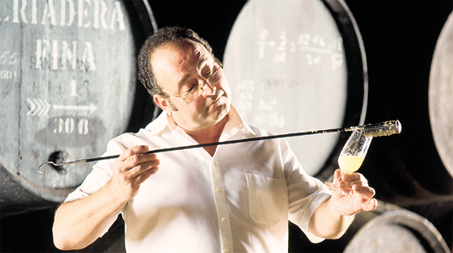
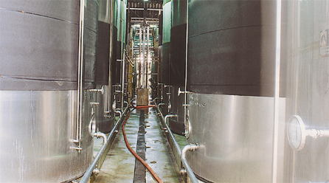
Sherry wine-making
Producing Sherry is a matter of...
nature
tradition
technology
The first steps – wine-making:
Pressing of the grapes
Classification of the musts
Fermentation
Base wine

Slide 14
Sherry wine-making
The base wine
End of november - the “deslío”.
Dry white wine.
11º to 12,5º alcohol.
Spontaneous development of the “flor” on the surface of the wine.
flor
vino en claro
lees

Slide 15
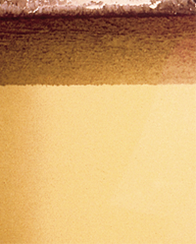
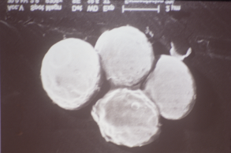
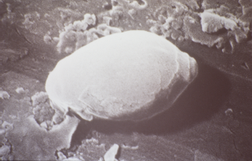
Sherry wine-making
Flor – the key to Sherry wines
Veil of natural (local) yeasts – different strains of Saccharomices Ellipsoideous.
Protects the wine from oxidation.
Permanent interaction with the wine.
Requires precise living conditions:
temperature
humidity
aeration...
… and alcoholic content.

Slide 16
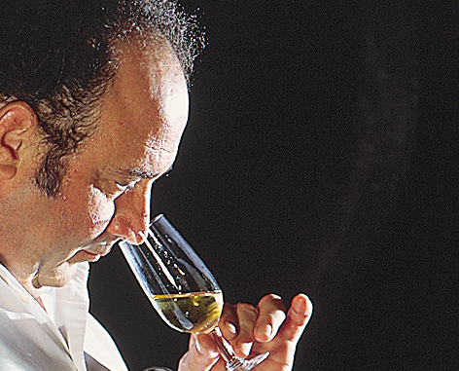
Sherry wine-making
The fortification
Sensorial classification
/
Pale and light wines: fino
O
Heavier, darker wines: oloroso
fortification = addition of pure wine distillate
objective: increase the wine´s alcoholic strength
/
O
Fino → fortified up to 15º
Oloroso → fortified up to 17º

Slide 17
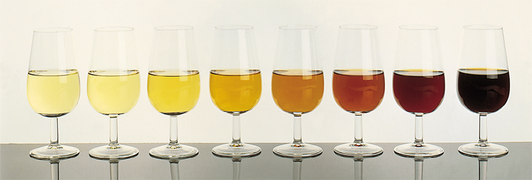
Sherry wine-making
The different levels of alcohol will determine
the future ageing of sherry inside the casks
at 15º alc.
The wine keeps the flor
at 17º alc.
The wine looses the flor
Biological ageing
The flor protects the wine from oxidation
Oxidative ageing
Without the flor, the wine is exposed to oxidation

Slide 18
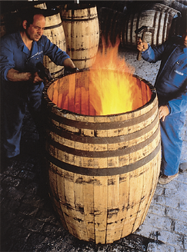
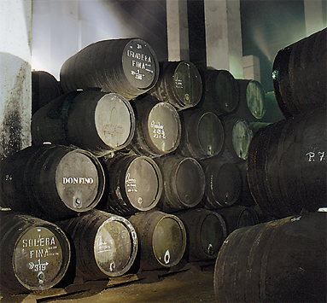

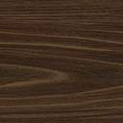
Sherry wine-making
The “crianza” – the ageing of Sherry
Use of oak “botas” (butts)
of American Oak.
Three years minimum ageing in wood.
Genuine ageing method of “criaderas y solera”.
American oak barrels
600 litres capacity
Only filled up to 500 litres

Slide 19
Sherry winemaking
The system of “ciaderas y solera”
A “dynamic” method of ageing wines.
Based on fractional blending of different vintages.
Different ageing systems for every style of wine.
Guarantees a consistent quality and personality for the wines, year after year.

Slide 20

Sherry wine-making
How does the solera work?
Year wine
2nd. criadera
“rocíos”
a n d a n a
1st. criadera
solera
“saca”

Slide 21
Sherry winemaking
The making of Sherry – the key ideas
Base wines: it all starts with a white wine with something unique - the flor.
Fortification level determines biological or oxidative ageing.
Special containers (botas) in special buildings (bodegas).
Minimum ageing period of three years.
The solera: a never-ending ageing system.
If you want to learn more... read this:
“Sherry, the Noble Wine” by Manuel M. González Gordon
“Sherry”, by Julian Jeffs
“Sherry and the Sherry Bodegas”, by Jan Read

Slide 22
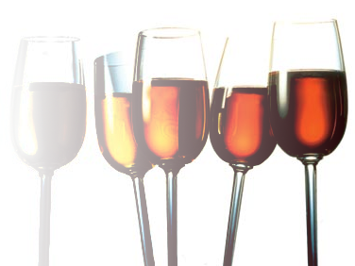
The diversity of Sherry wines
Two key factors determine Sherry´s enormous diversity
The level of
oxidation
The level of
sweetness
manzanilla
dry
fino
amontillado
oloroso
sweetness
pale
medium
dark
Determined by the type of ageing
Determined by the residual sugars
pale cream
cream
sweet
moscatel
pedro ximénez
oxidation

Slide 23
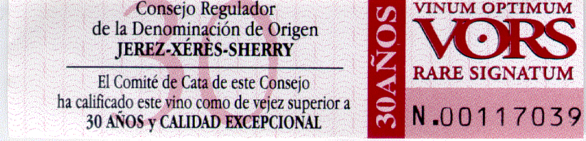
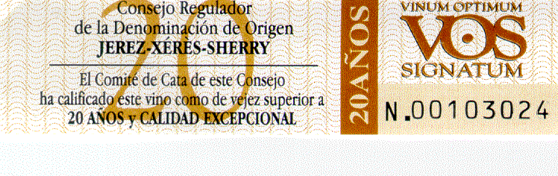
The diversity of Sherry wines
The dimension TIME in Wood.
30 +
20 +
12 & 15
6 +
3 +

Slide 24
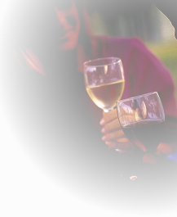
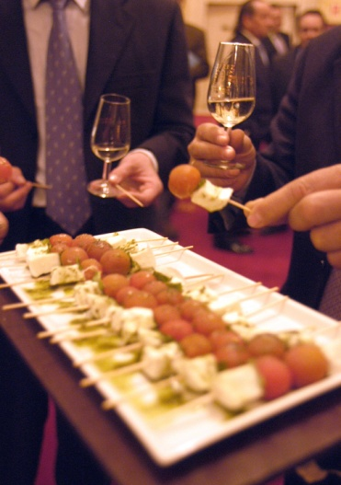
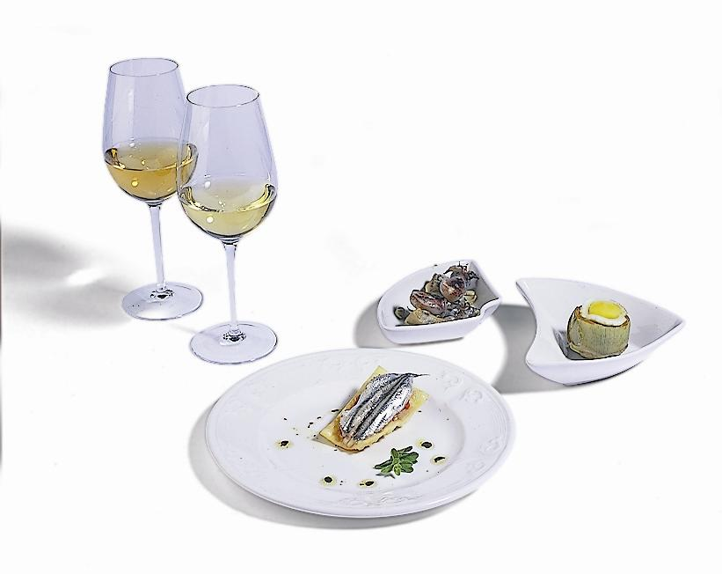
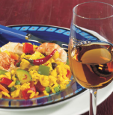
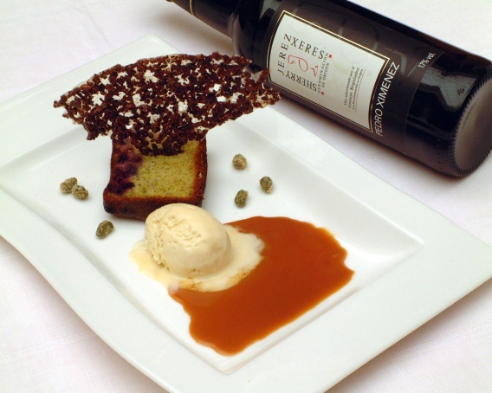
enjoying sherry
Sherry and food
Apart from being an ideal aperitif, Sherry is also the perfect companion for many dishes.
This is the way it is drunk in Spain → with Tapas.
A different, diverse and powerful taste.
Great alternative for matching with some foods. Often the only one.
Ingredient and companion at the same time.

Slide 25
enjoying sherry
Sherry and food
Some examples...
Fino / Manzanilla all kinds of “tapas”, seafood, white fish and mild cheese.
Amontillado soups and consommes, white meat, blue fish and cured cheese.
Oloroso poultry, game and red meat; tuna.
Medium (slightly chilled) patés and quiches.
Pale Cream (cold) foie-gras and fresh fruit.
Cream desserts (also a great aperitif served on ice!).
Pedro Ximénez deserts, ice creams and blue cheese.

Slide 26
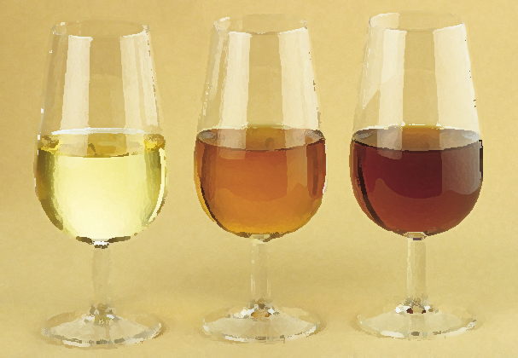
The diversity of Sherry wines
Dry styles of Sherry
FINO
OLOROSO
MANZANILLA
AMONTILLADO
PALO CORTADO
BIOLOGICAL AGEING…………………...……….OXIDATIVE AGEING

Slide 27
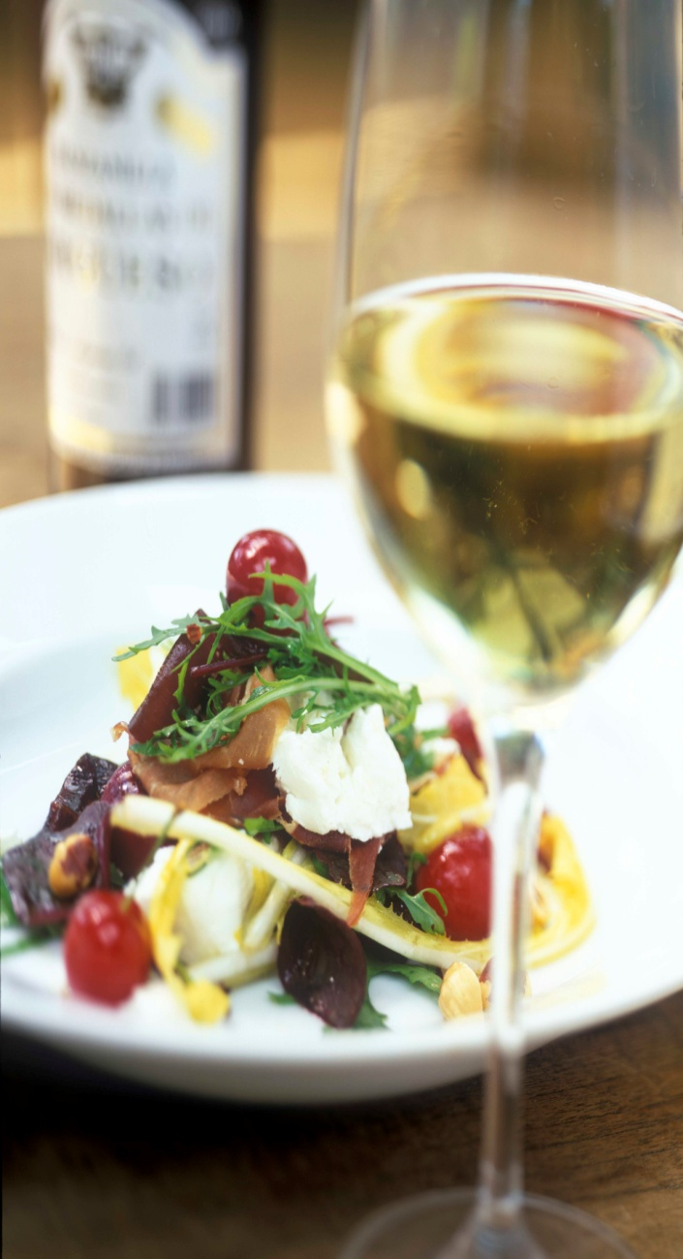
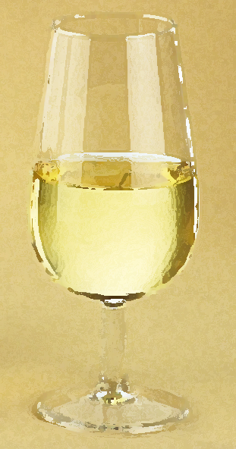
The diversity of Sherry wines
Manzanilla fina
Very pale, straw yellow colour.
Pungent, yeasty nose with hints of almonds and camomile.
Dry, fresh, delicate and nicely bitter in the palate, with salty notes.
Very light overall impression.
Alcohol content between 15 and 17% vol.
Less than 1 gram of sugar per litre
Total acidity (tartaric) <3,5 grams / litre
Volatile acidity (acetic) <0,2 grams / litre
Very low level of glycerine

Slide 28
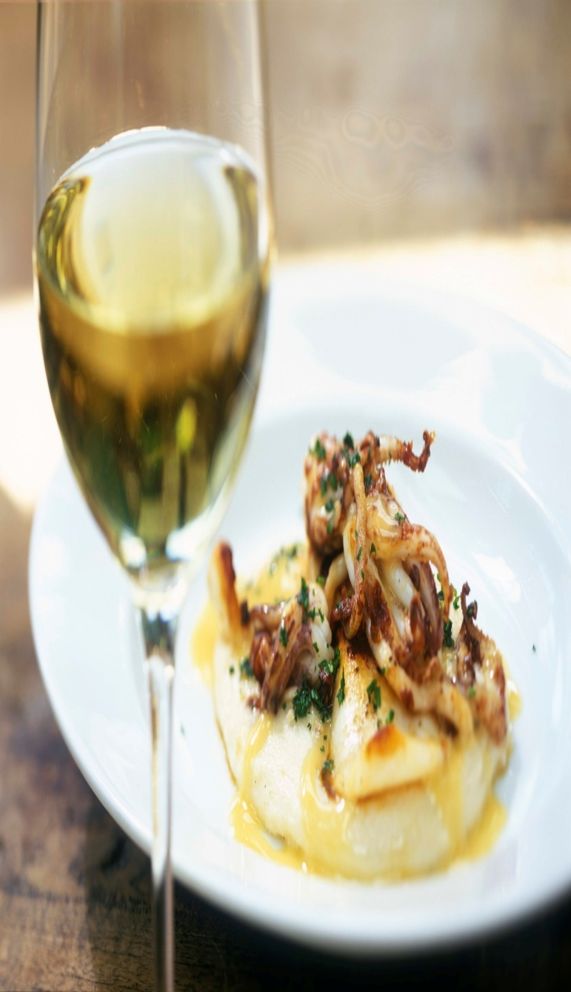
The diversity of Sherry wines
Fino
Aged exclusively through biological ageing (evolution under flor).
Pale, straw yellow colour.
Pungent nose, with hints of yeasts (fresh dough) and dry fruits (almonds).
Dry, light, delicate taste.
Alcohol content between 15 and 17% vol.
Less than 1 gram of sugar per litre
Total acidity (tartaric) <3,5 grams / litre
Volatile acidity (acetic) <0,2 grams / litre
Very low level of glycerine

Slide 29
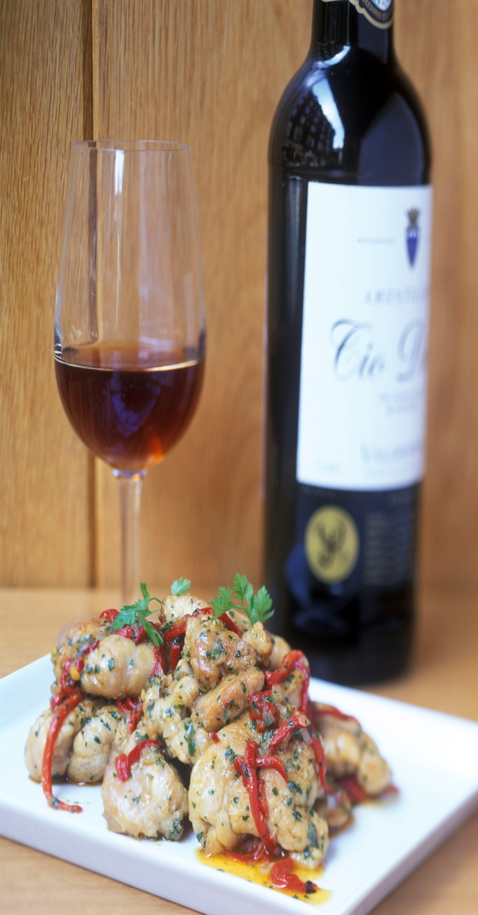
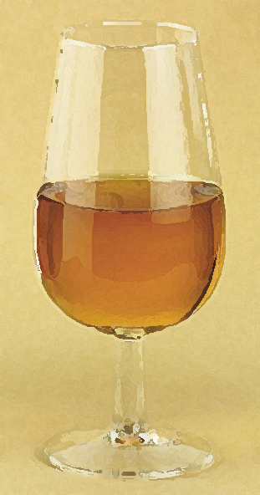
The diversity of Sherry wines
Amontillado
Partially aged with flor: both biological and oxidative ageing.
Amber to pale mahogany colour.
Slightly pungent, with a deep, complex, nutty nose.
Light and smooth, round in the palate, with a long after-taste.
Alcoholic content between 16 and 22% vol..
Less than 5 grms. of sugar per litre
Total acidity (tartaric) <5 grams / litre
Volatile acidity (acetic) <0,8 grams / litro

Slide 30
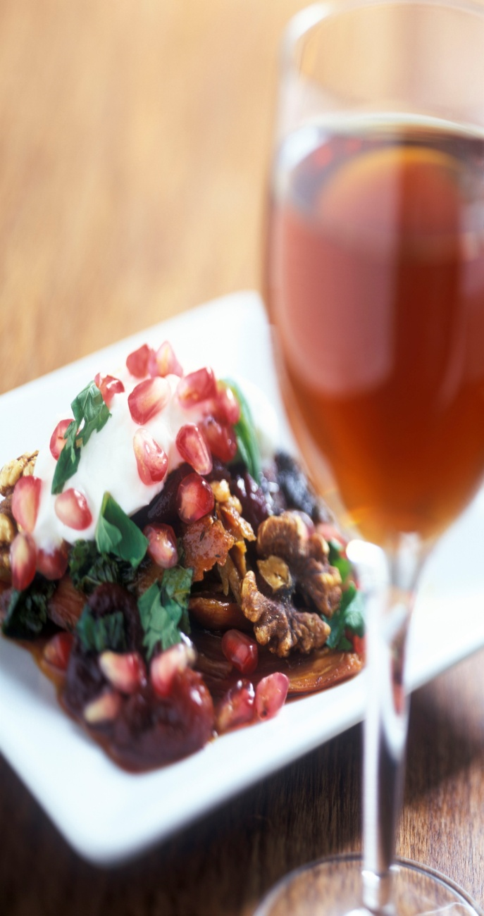
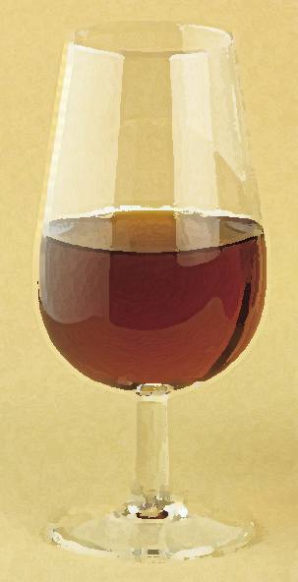
The diversity of Sherry wines
Oloroso
Exclusively oxidative ageing.
Intense mahogany colour, darker as the wine gets older.
Very deep aromas (oloroso). Warm, round and complex.
Smooth and full bodied. Glyceric and with a very long after-taste.
Alcohol content between 17 and 22% vol.
Less than 5 grms. of sugar per litre
Total acidity (tartaric) <5 grams / litre
Volatile acidity (acetic) <0,8 grams / litre

Slide 31
The diversity of Sherry wines
Palo cortado
An exceptional, very rare wine, produced through long oxidative ageing of very fine wines.
Bright mahogany colour.
Encompasses the delicate, slightly pungent nose of amontillados with the structure and depth of olorosos.
Shows a characteristic lactic note.
Alcohol content between 17 and 22% vol.
Less than 5 grams of sugar per litre
Total acidity (tartaric) <5 grams / litre
Volatile acidity (acetic) <0.8 grams / litre

Slide 32
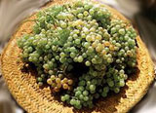
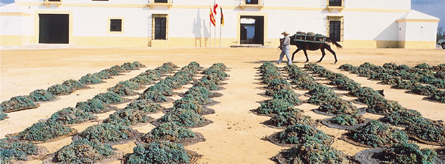
The diversity of Sherry wines
Natural Sweet Wines
Use of specific grape varieties: Pedro Ximénez & Moscatel.
Extra maturation of grapes through sun- drying of the grapes (“soleo”).
Partial fermentation of the grape must.

Slide 33
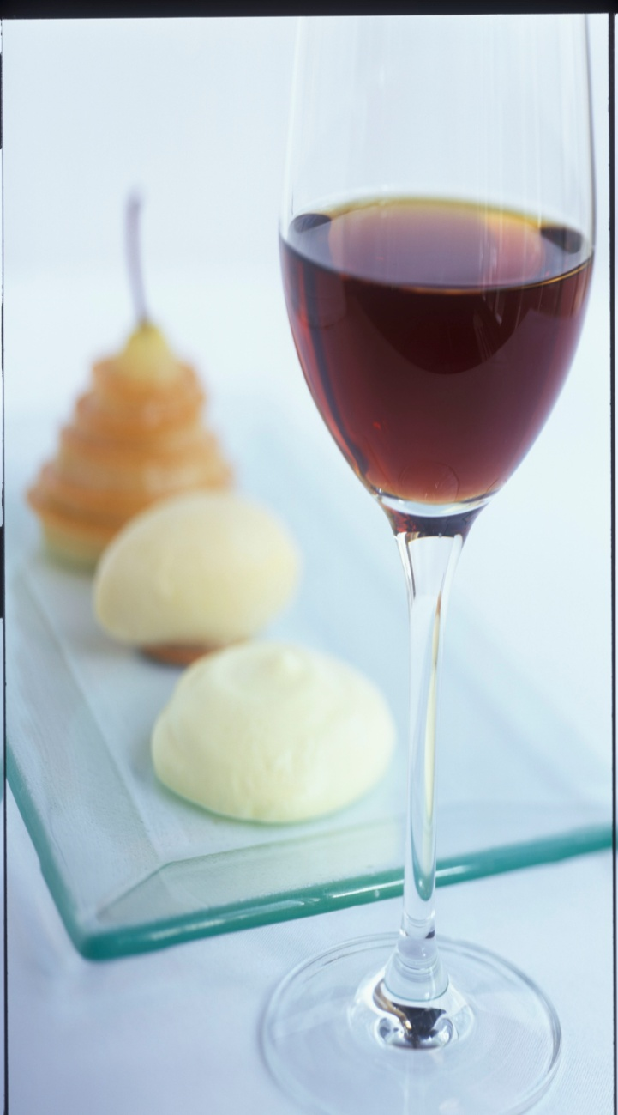
The diversity of Sherry wines
Cream
Dark mahogany colour. Dense appearance.
Intense aroma of oloroso, combined with notes of raisined grapes.
Full bodied, sweet and velvety in the palate.
Alcohol content between 15,5 and 22% vol.
More than 115 grms. of sugar per litre
Total acidity (tartaric) <3,5 grams / litre
Volatile acidity (acético) <0,6 grams / litre

Slide 34
The diversity of Sherry wines
Palo cortado
An exceptional, very rare wine, produced through long oxidative ageing of very fine wines.
Bright mahogany colour.
Encompasses the delicate, slightly pungent nose of amontillados with the structure and depth of olorosos.
Shows a characteristic lactic note.
Alcohol content between 17 and 22% vol.
Less than 5 grams of sugar per litre
Total acidity (tartaric) <5 grams / litre
Volatile acidity (acetic) <0.8 grams / litre

Slide 35

The diversity of Sherry wines
Natural Sweet Wines
Use of specific grape varieties: Pedro Ximénez & Moscatel.
Extra maturation of grapes through sun- drying of the grapes (“soleo”).
Partial fermentation of the grape must.

Slide 36
The diversity of Sherry wines
Cream
Dark mahogany colour. Dense appearance.
Intense aroma of oloroso, combined with notes of raisined grapes.
Full bodied, sweet and velvety in the palate.
Alcohol content between 15,5 and 22% vol.
More than 115 grms. of sugar per litre
Total acidity (tartaric) <3,5 grams / litre
Volatile acidity (acético) <0,6 grams / litre

Slide 37
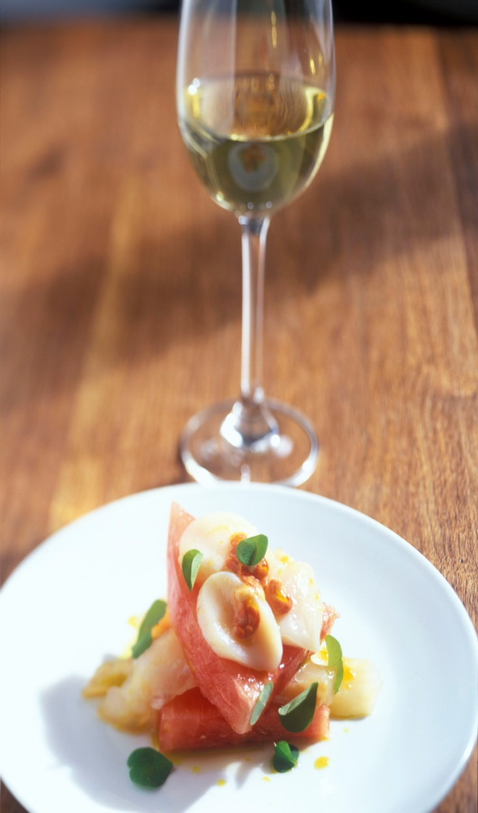
The diversity of Sherry wines
Pale Cream
Pale, straw yellow colour.
Notes of almonds and of biological ageing. Slightly pungent.
Sweet, light and fresh in the palate.
Alcohol content < 15,5% vol.
More than 100 grms. of sugar per litre
Total acidity (tartaric) <3,5 grams / litre
Volatile acidity (acético) <0,2 grams / litre

Slide 38
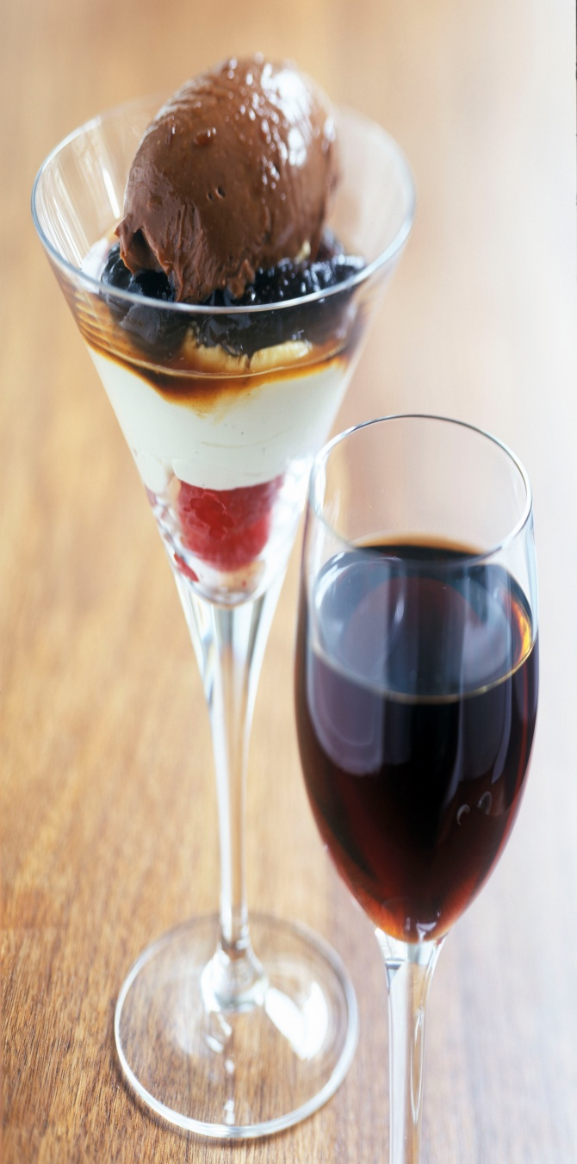
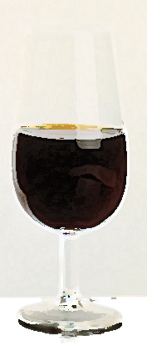
The diversity of Sherry wines
Pedro Ximénez
Extremely dark mahogany colour and dense, syrupy appearance.
Deep aromas of dried fruits (raisins), gaining complexity with ageing: toffee, licorize...
Very sweet taste, with a smooth, velvety texture. Very long after-taste.
Alcoholic content between 15 and 22% vol.
Between 400 and 500 grms. of sugar per litre
Total acidity (tartaric) 4-5 grams / litre
Volatile acidity (acetic) +0,4 grams / litre

Slide 39
enjoying sherry
Remember... Sherry is a Wine
To enjoy at its best, it should be consumed within a reasonable period after purchase. Try and buy Fino and Manzanilla from outlets with good turnover for freshness.
type of Sherry sealed bottle open bottle
fino / manzanilla 12 to 18 months one week (*)
amontillado / medium 18 to 36 months 2 - 3 weeks
oloroso / cream 24 to 36 months 4 - 6 weeks
pedro ximénez 24 to 48 months 1 - 2 months
(*) kept in the fridge, properly closed.

Slide 40

enjoying sherry
How should I store the bottles?
As for any other quality wine, find a quiet place, with stable temperature, safe from strong light and vibrations.
Keep the bottles standing up, so that the surface in contact with the air inside the bottle is reduced to a minimum.
Once unsealed, keep the bottles properly closed, and if there is not much wine left in the bottle...
...find a good excuse to finish it!

Slide 41
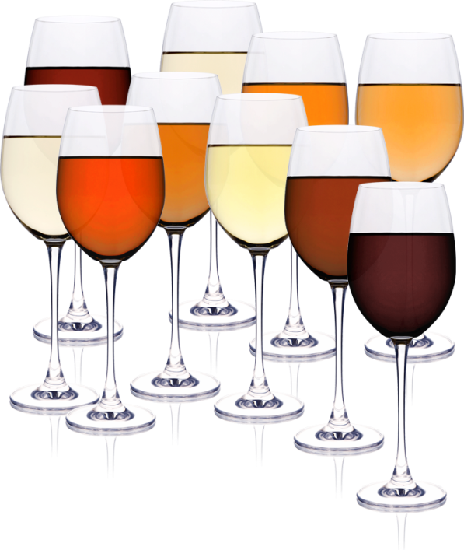
enjoying sherry
What kind of glasses for Sherry?
The traditional “catavino” or “copita” is the ideal glass for drinking Sherry.
However, any good quality wine glass with the proper bowl (in order to allow the “breathing” of the wine) and stem (to avoid warming up) would allow us to enjoy Sherry. Drink and treat as you would a white wine.
CONSEJO REGULADOR
AULA DE FORMACIÓN

Slide 42
enjoying sherry
Serving temperatures
Except for fino and manzanilla (always well chilled) there are no strict rules for serving Sherry.
recommended temperatures
Fino & Manzanilla – always very cold, between 7 and 9 º C.
Pale Cream at approximately 10º C.
Medium, lightly chilled, at about 10 - 11º C.
Cream is best enjoyed at approximately 13º C, although it is also delicious as an aperitif “on the rocks”.
dry Amontillado and dry Oloroso, between 13 and 14º C.
Pedro Ximénez, at approximately 15º C.

Slide 43
enjoying sherry
Enjoying Sherry – the key ideas
Sherry is a wine – and should be used as such...
Fino & Manzanilla ALWAYS chilled.
An amazing wine for food.
Versatility – a key strength of Sherry.
If you want to learn more... read this:
“Cooking with Sherry” by Lalo Grosso de MacPherson

Slide 44
Enjoy Sherry
SOON & OFTEN!

